Slide 1
International Health Regulations
Prof Chrishantha Abeysena

Slide 2
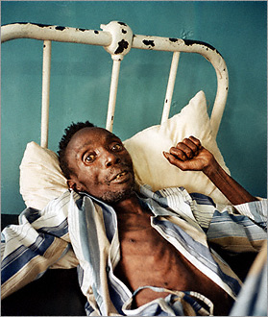
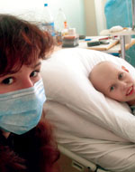
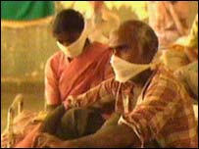
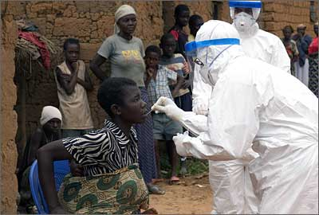
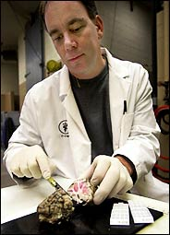
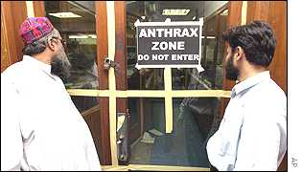
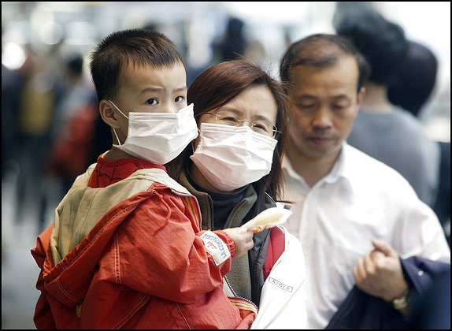
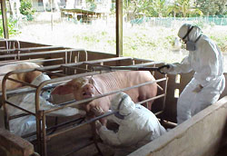
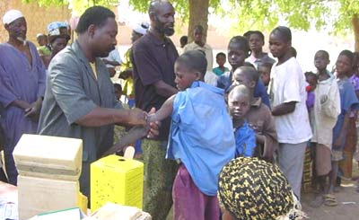
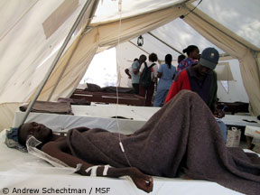
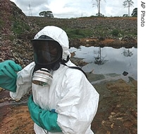
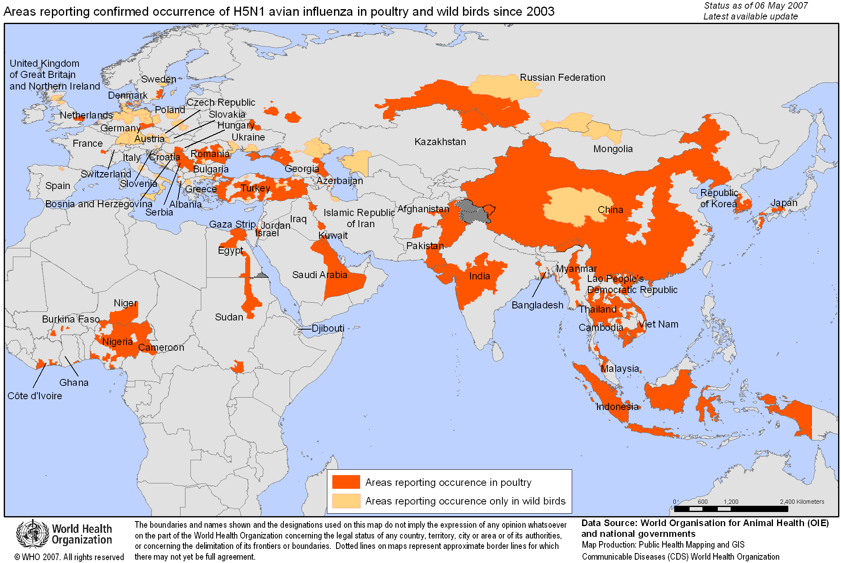
Global threats : International Health Security 1980 - 2016
HIV/AIDS
XDR-TB
Anthrax
SARS
Avian Flu
Chemical pollution
Zika
meningitis
cholera

Slide 3
Global threats: why are we concerned?
Epidemics not new, but….took days, weeks/months to reach far territories
Emergence/re-emergence of infectious diseases and increased pace of spread
Threat of deliberate use of biological and chemical agents
Impact on health, economy, security

Slide 4
What are IHR (2005)? A global framework
Legally-binding global agreement to protect public health
The international commitment for shared responsibilities and collective defence against disease spread

Slide 5
Why have IHR (2005)?
Serious and unusual disease events are increasing and inevitable
Globalisation– public health event in one location can be a threat to others
Need for collective effort and agreed rules
strong national public health system
international alert & response system

Slide 6
Purpose of IHR (2005)
“To prevent, protect against, control and provide a public health response to the international spread of disease
in ways that are commensurate with and restricted to public health risks, and
which avoid unnecessary interference with international traffic and trade” – (Article 2)
Notes:
Not intended to "interfere" with purely national events UNDER CONTROL
The traffic and trade objective comes AFTER the health objective

Slide 7
Broad scope and coverage of IHR (2005)
“Disease” under IHR (2005)
“an illness or medical condition, irrespective of origin or source
that presents or could present significant harm to humans”
“Event”: “a manifestation of disease or an occurrence that creates the potential for disease”
"Public health risk": "the likelihood of an event that may adversely affect the health of human populations, …"

Slide 8
Scope of IHR (2005): what does it include?
Events/risks may be:
Biological/infectious, chemical, radionuclear
Known or unknown, emerging or re-emerging
Transmissible by persons, transport conveyances, cargo/goods food/animals/products), vectors, environment, etc.
Notification: All events that may constitute a public health emergency of international concern (PHEIC)
Significant/potentially international public health risks
Notes:
The old IHR only covered three diseases: Plague, yellow fever and cholera. However, the new IHR address much broader issues.

Slide 9
International Health Regulations (2005)
1969 IHR covered 3 diseases: YF, cholera, plague
Revision started 1995 –adopted by all States in 2005
IHR in force, and implemented, globally since 2007 Legally binding on 194 States Parties
Concerns during revision included - Zoonoses e.g. Ebola, SARS, avian influenza, future serious potentially unknown international risks

Slide 10
International Health Regulations (2005)
Apply to government as a whole, not just particular ministry, department or agencies
Broad / open disease scope for early warning/response & to catch emerging risks
Overall framework: surveillance, response, support, information sharing, capacities
Does not replace existing regulatory regimes
Does mandate collaboration

Slide 11
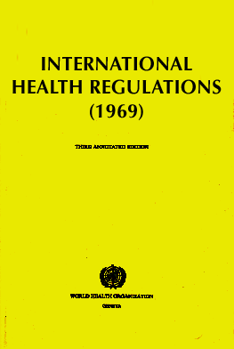
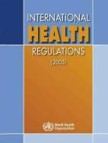
IHR(2005): a paradigm shift
From control of borders to (also) containment at source
From diseases list to all threats
From preset measures to adapted and real time response

Slide 12
Highlights of IHR (2005)
Much broader scope
National IHR Focal Point & competent authorities
Consultation, notification, verification & assessment
Recommended measures from WHO in public health emergencies of international concern
National core capacity requirements

Slide 13
National IHR Focal Point
The national centre for communications with WHO
On a 24/7 basis
NOT an individual person
Legally required functions
Sending urgent communications to WHO
Disseminating information to and consolidating inputs from relevant governmental sectors/institutes/agencies
Potential additional tasks as determined by State:
Risk assessment, coordinated response etc.
Notes:
One of the important new obligations is the designation or establishment of National IHR Focal Points (NFPs).
The NFP refers to the National Centre for communications with WHO. It is NOT an individual person, [although having a contact person for the NFP is important]
The NFP MUST be accessible at all times by communication means such as telephone, fax and email.
There are legally required functions to be performed by the NFP.
In order to ensure the NFP functions are met, there is also a need to establish multi-sectoral/agency communication mechanisms and procedures. This is particularly important for smooth communications with other relevant government sectors and with WHO, concerning the IHR implementation.

Slide 14
Importance of national capacity
The best way to prevent international spread of diseases is to detect public health threats early and implement effective measures when the problem is small and at local level
Notes:
Increasing recognition that WHO cannot replace or make up for weak or missing capacity at national level

Slide 15
Government areas and functions affected by International Health Regulations
Public health
Environment
Radio-nuclear and chemical activities / safety
Customs
Food safety
Agriculture (and animal health)
International ports, airports, ground crossings
Transportation (including dangerous goods)
Collection, use and disclosure of public health information
Activities of authorities at national, provincial/district, local levels.

Slide 16
Development of core public health capacities for surveillance and response
All States Parties must develop/maintain national minimum public health capacities, including surveillance, assessment & response
Required capacities: Detect, assess, control and report internally on public health events – according to specified criteria
At all levels and throughout national territory

Slide 17
National IHR Core Public Health Capacities: Monitoring and reporting
8 Core capacities
Legislation and Policy
Coordination
Surveillance
Response
Preparedness
Risk Communications
Human Resources
Laboratory
3 levels
National
Intermediate
Peripheral/Community
Potential Hazards
Biological
Infectious
Zoonosis
Food safety
Chemical
Radio nuclear
Events at Points of Entry

Slide 18
Surveillance and response capacity
At local level
Detection of events
Reporting
Control measures
At intermediate levels
Confirmation
Assessment
Reporting
At national level
Assessment
Notification (to WHO)
Public health response
Control measures
Support (staff, lab)
On-site assistance
Operational links/liaison
Public health emergency response plan
On 24 hour basis
Notes:
This slide summarizes the core capacity requirements for surveillance and response under the IHR (2005).
At local level, there MUST be capacity to detect any unexpected event and report to intermediate level and IMMEDIATELY implement basic public health measures.
At intermediate level, there MUST be capacity to confirm, respond and assess the events, and report urgent events to national level
At national level, there MUST be core capacities for assessment AND RESPONSE CONCERNING urgent events reported and for REPORTING TO WHO of any event that may constitute a PHEIC within 24 hours through National IHR Focal Points.

Slide 19
Verification of events
Value of unofficial sources of information for early alert (to be assessed and verification requested)
WHO mandated to seek verification (from State Party in which event arising) of events which may be emergencies of international concern
States Parties must give initial reply within 24 hours and provide of information
Offer On-site assessment, when necessary
Notes:
Past experience shows that many significant public health events have been often firstly reported by media or other unofficial sources.
Under the IHR (2005), WHO is obligated to SEEK verification of EVENTS WHICH MAY BE public health EMERGENCIES of international concern.
STATES PARTIES need to provide initial reply within 24 hours.
When necessary, WHO WILL OFFER TO COLLABORATE IN MOBILIZING INTERNATIONAL ASSISTANCE TO SUPPORT STATES PARTIES IN ON SITE ASSESSMENTS.

Slide 20
Event notification
Any event that may constitute a public health emergency of international concern (PHEIC)
To WHO within 24 hours of national assessment
Continue to provide WHO with detailed public health information including: case definition, cases/deaths, conditions affecting spread, measures
Does NOT mean an actual “PHEIC” is necessarily occurring

Slide 21
What is a Public Health Emergency of International Concern (PHEIC)?
PHEIC is an extraordinary event which is determined, as provided in these Regulations:
to constitute a public health risk to other States through the international spread of disease and
to potentially require a coordinated international response.
Notes:
The IHR require procedural steps by the DG/WHO in determining that a PHEIC exists and in determining the specific temporary recommendations to States of appropriate health measures. These include the obligation to seek the (nonbinding) views of the outside experts on the Emergency Committee: (1) always for the temporary recommendations and (2) also for the determination that a PHEIC is occurring—except it is not required to determine a PHEIC is the State agrees that one is occurring. There are others as well.

Slide 22
PHEIC
a situation that is:
serious, sudden, unusual or unexpected;
carries implications for public health beyond the affected State’s national border; and
may require immediate international action.

Slide 23
Determination of a PHEIC
DG of WHO determines whether an event constitutes a PHEIC
5 key criteria:
Information from the State / States
Decision instrument
Advice of the Emergency Committee
Scientific principles, scientific information, other relevant information
Risk assessment: to human health, of international spread and interference with international traffic

Slide 24
Declared PHEIC
pandemic influenza H1N1 in 2009,
re-emerging wild-type poliovirus in April, 2014,
Ebola virus disease in west Africa in August, 2014,
the emergence of new diseases such as Middle East respiratory syndrome coronavirus and influenza H7N9
ZIKA in 2016

Slide 25


PoE Core capacity requirements at all times (routine)
(b) Equipment & personnel for transport ill travellers
(a) Assessment and Medical care, staff & equipment
(e) Trained staff and programme for vector control
(c) Trained personnel for inspection of conveyances
(d) ensure save environment: water, food, waste, wash rooms & other potential risk areas - inspection programmes

Slide 26

Designated Ports of Entry: Core capacity
requirements for responding to potential PHEICs
b
PH assessment & care for affected travellers, or animals
Space to interview suspect or affected persons
c
PH emergency response, development of a contingency plan
a
Assessment, quarantine of suspect travellers, if required.
d
g
Entry/exist control for departing & arriving passengers
e
Access to required equipment and trained personnel
f
Implementation of recommended measures such as disinfection
Notes:
This shows the capacity requirements for responding to potential public health emergencies of international concern at designated airports, ports and ground crossings.

Slide 27
IHR (2005): Rapid Containment
Index
Cluster
Two important aspects
IHR (2005) as an opportunity to strengthen core capacity for early detection and assessment of Index Cluster
Containment operation in line with IHR requirements, when applicable
Risk assessment &
Decision-making
Containment
Operation
Monitoring

Slide 28
Rapid containment operation
Some IHR requirements for international travellers may apply:
Measures applied to arriving or departing international travellers
Measures applied to travellers inside the country in course of departing
IHR provisions that may affect potential interventions:
Informed consent before prophylaxis, other measures etc
Care of travellers subject to quarantine/isolation etc (food, medical care…)
Measures must be applied in transparent and non-discriminatory manner
Respect for fundamental human rights

Slide 29
Public health security at points of entry(PoE) to Sri Lanka
Two international airports
(Katunayake and Mattala) and
Four sea ports
(Colombo, Galle, Hambantota, Trincomalee).

Slide 30
The routine activities carried out at the PoE
Mainly focus on preventing the introduction of infectious diseases into Sri Lanka.
History of port health laws in Sri Lanka dates back to 1897 with the establishment of the ‘Quarantine and Prevention of Diseases’ Ordinance,
Which stipulates provisions for preventing the introduction of all contagious and infectious diseases into Sri Lanka.

Slide 31
Implementation of IHR (2005) in SL
The Directorate for Quarantine was established by the Ministry of Health in 2008 to ensure the implementation of IHR (2005).
Two national focal points were appointed
Director Quarantine and
Chief Epidemiologist for IHR communications with the WHO and all relevant sectors within the country.

Slide 32
Implementation of IHR (2005) in SL…
Sri Lanka has already designated national focal points
Director General of Animal Production and Health for zoonotic infections
Director Environment and Occupational Health Unit, for foodborne disease
Chairman-Central Environment Authority for chemical hazards
Chairman-Atomic Energy Regulatory Council for radio-nuclear hazards

Slide 33
Conclusion
IHR (2005) is legal framework to protect public health
The decision instrument is a useful (and required) tool to assess and notify WHO about a PHEIC
Key provisions apply to and support rapid containment including
Strengthening core public health capacities
Rapid notification and communication with WHO
Joint assessment

